Slide 1
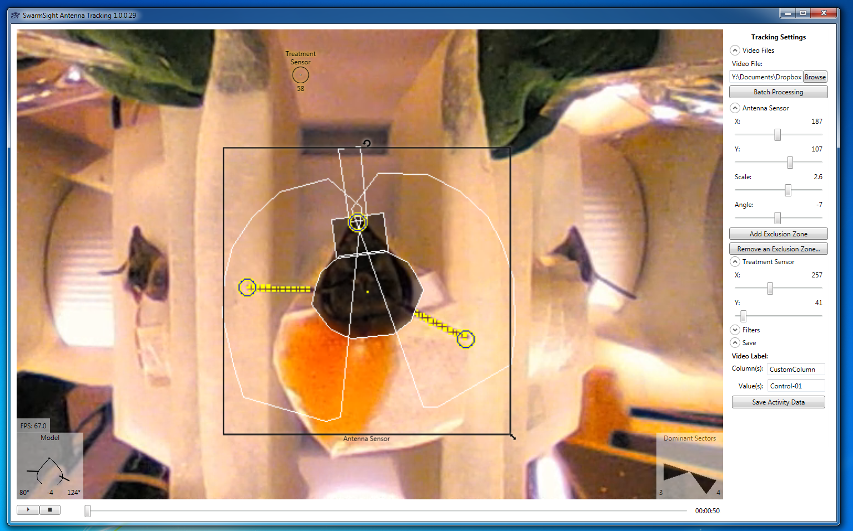
PER-Y
AntennaSensorOffset-Y
TreatmentSensor
RightFlagellumBase-Y
AntennaSensorScale-X/Y
RightFlagellumTip-Y
RotationAngle
PER-X
RightFlagellumBase-X
AntennaSensorHeight
RightFlagellumTip-X
Left/RightSector
AntennaSensorOffset-X
AntennaSensorWidth
CustomColumn

